Slide 1
Workbook Cash Flow (Planning)
Internal Use Only
April 2017
EXCEL FILE:

Slide 2
Disclaimer
The content of this workbook has been produced by KPMG Germany/Deal Advisory on the basis of German accounting standards and/or IFRS, as well as considering KPMG Germany’s firm and country requirements, regulations, processes, policies and best practices. Please check your local accounting and other requirements before applying the content.

Slide 3
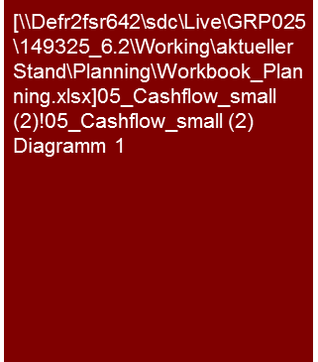
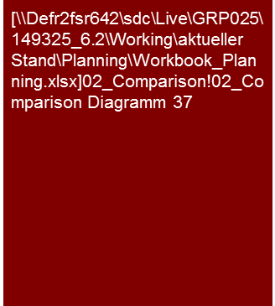
Overview (1/4) – Mission statement
Cash Flow (Planning)
Flag: The presentation of cash flow deviates from accounting standards. This workbook contains sample financial statements according to IFRS and German GAAP
Tools listed are commonly used in Germany and may differ in other regions.
Mission Statement:
Cash doesn’t lie. Cash flow is the key for the valuation and ability to restructure and unifies the results from the P&L and balance sheet analysis
Customer situation
Definition/Methodology/Tools of the basis analysis
Buy Side/Sell Side/JV
Cash flow main parameter of the valuation and therefore the determination of the purchase price
Turnaround
Ability to transfer operative activity into liquidity
What means are available to the debt provider?
Basis for covenants
Cash conversion rate and free cash flow in % of the net sales
Definition and Methodology
Cash flow shows to what extent the company is in the position to generate funds for its investors from its business model
Cash conversion rate = (Free) cash flow/EBIT(DA)
Definition consistent with past analysis (→ workbook Cash Flow (historical) and dependent on the purpose of the analysis
For restructuring: Cash flow available for debt service (important definition of the cash flow statement)
For purposes of valuation: Cash flow for equity provider (cash flow to equity) or liabilities and equity provider (free cash flow, total cash flow,…)
Analysis of the origin and utilization: Breakdown in operative CF (if applicable before/after interest and taxes), CF from investments, CF from financing (importance of the CF sector-dependent) if applicable CF from restructuring measures, extraordinary effects and CF non-operating assets separate
Derivation performed especially middle and long-term generally indirectly from P&L and balance sheet, short-term also directly (especially with reorganization/restructuring - RES)
With indirect derivation utilization of an integrated planning model to assure consistency with P&L and balance sheet planning
Tools
Analysis Toolbox
Benchmarking
Cash conversion rate in comparison to peers
Degree of standardization
Toolbox for analyses
Determination and collection of sector-specific KPIs (Benchmarking Project)

Slide 4
Overview (2/4) – Diagram
Cash Flow (Planning)
Indirect cash flow derivation
Direct cash flow derivation
P&L
Balance sheet
Deposits
Payments
Cash conversion rate
Cash flow
Cash flow
Generally annual basis
Middle to long-term horizon (3-10 years)
Basis should normally be an integrated planning model (balance sheet and P&L planning) (starting point actual last year)
Utilization for e.g. valuation models
Generally monthly basis
Short-term horizon (as a rule max. 12 months)
Utilization for liquidity planning

Slide 5
Overview (3/4) – Pitfalls
Cash Flow (Planning)
No. | Pitfalls/Lessons learned
 | Completeness: Were all the balance sheet items really considered in the indirect cash flow derivation? If this is not the case unintended cash effects (e.g. provisions) may result from transactions that are actually cash neutral.
 | Strongly fluctuating cash conversion rate (CCR): A strongly fluctuating CCR is frequently an indication that the P&L results are a poor indication for the company’s generated cash flow. If this is the case, the entire analysis is directed more at cash flow parameters than the P&L results such as EBITDA/EBIT, due to the fact that these have only limited validity.
 | Cash flow must be adapted to valuation procedure applied. Especially the questions: Do the capital costs match the cash flow?: Equity-Cash flow → Cost of equity, Total capital-Cash flow (e.g. FCF) →Total cost of capital (e.g. WACC) Where the tax advantage of debt financing is considered and frequently a source of errors (if already in cash flow (actual instead of adjusted tax burden) then no longer in the costs of capital and not vice-versa)
1
2
3

Slide 6



Overview (4/4) – Core issues
Cash Flow (Planning)
Core Issue | Specific analysis | Page(s)
What cash flows are available to providers of capital and what are the main drivers for changes over time? | Discuss past analysis and the cash flow definition selected as well as historically achieved cash flow Analysis of the composition and amount over time Link to planning, investment, financing and working capital analysis, already analyses in the major trends, drivers and assumptions With valuation: If applicable explanation of the valuation-technical particularities, e.g. adjusted taxes on EBIT with FCF | 7-9
2. To what extent is the company able to convert operative results or sales into cash flows over time? | Analysis of cash conversion rate and cash flow in % of sales Analysis of the reasons for changes in the KPIs over time (e.g. working capital requirements for expansion) – close connection to the balance sheet analysis and understanding of the business model | 10
Does the planned cash flow correspond to market expectations (benchmarking)? | Comparison of cash conversion rate and cash flow in % of sales to market studies and KPIs of peer group companies (benchmarking) – Note: Pay attention to uniform definition and approach (e.g. leasing vs. purchase)! Comparison of planned cash flow to analysts’ expectations Identify and analyze explanation for possible deviations from market expectations | 11

Slide 7
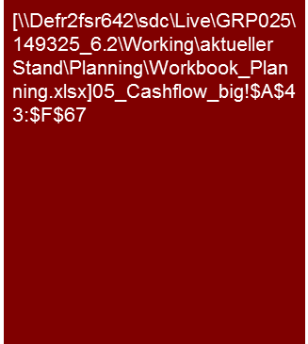
1. What cash flows are available to providers of capital and what are the main drivers for changes over time?
Cash Flow (Planning)
Alternative for Valuation CF
The free cash flow increases in the course of planning from X to Y.
Main causes for this are the expected increases in the operative result as well as the planned decline of the investments in the planning period.
Tables for valuation method (FtE, WACC, TCF, APV, DDM) see K-Out
Tools
Excel analysis

Slide 8
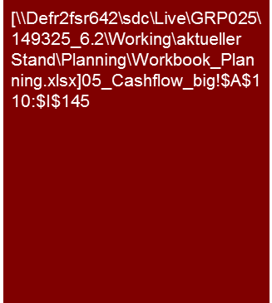
1. What cash flows are available to providers of capital and what are the main drivers for changes over time?
Cash Flow (Planning)
Alternative
[Core statement]
Presentation in the main section limited to major items, complete list in appendix
Tools
Excel analysis

Slide 9
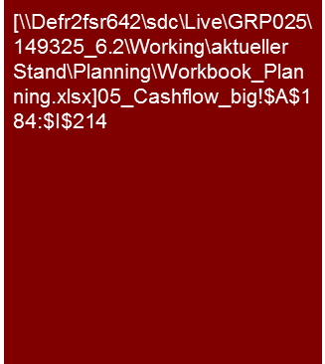
1. What cash flows are available to providers of capital and what are the main drivers for changes over time?
Cash Flow (Planning)
Alternative
[Core statement]
If applicable, separate presentation of CF from restructuring and non-operating assets
Presentation in the main section limited to major items, complete list in appendix
Tools
Excel analysis

Slide 10
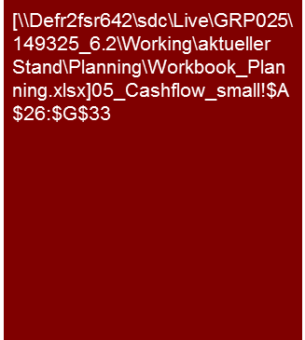
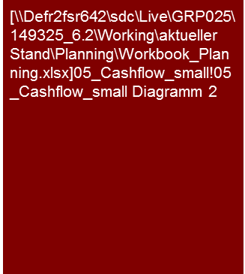
2. To what extent is the company able to convert operative results or sales into cash flows over time?
Cash Flow (Planning)
Ca. X % of the EBITDA is available to the investors as free cash flow.
The XXX AG expects to generate a greater degree of cash flows from its operations in the planning period.
The reason for this is XX
Description
[... description of development and definition of CCR ...]
[... description of reasons for development (e.g. higher CCR through optimization of WC) ...]
EBITDA to free cash flow conversion and FCF in % of sales
Actual
Plan
Definition of CCR as a rule individual case or sector-dependent.
Frequently FCF or operative CF with reference to EBITDA or EBIT, partially also annual result
Tools
Excel analysis

Slide 11

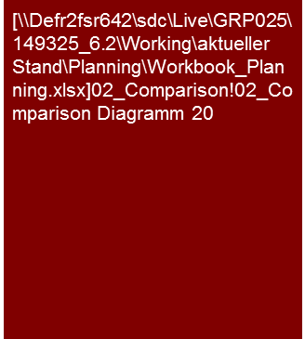
3. Does the planned cash flow correspond to market expectations (benchmarking)?
Cash Flow (Planning)
The EBIT to free cash flow conversion of XXX AG is comparable to the average conversion of the competitors and the expectations of the analysts.
In view of this we consider the expected EBIT to free cash flow conversion to be XXX.
EBIT to free cash flow conversion in comparison to peer group
Description
[... Description of analysis object to peers ...]
[... If deviant explain reasons for this or consequences resulting for planning → adjustments (if applicable also with sustained result/CF), scenarios, etc. ...]
XXX
EBIT to free cash flow conversion in comparison to analysts‘ expectations
Alternatively present free cash flow in % of sales, if recommendable
Tools
Excel analysis

Slide 12
Internal use only.
© 2016 KPMG International Cooperative (“KPMG International”), a Swiss entity. Member firms of the KPMG network of independent firms are affiliated with KPMG International. KPMG International provides no client services. No member firm has any authority to obligate or bind KPMG International or any other member firm vis-à-vis third parties, nor does KPMG International have any such authority to obligate or bind any member firm. All rights reserved.

